Slide 1
Chapter 3
Inheritance and Class Hierarchies

Slide 2
Chapter Objectives
To understand inheritance and how it facilitates code reuse
To understand how C++ determines which member function to execute when there are multiple member functions with the same name in a class hierarchy
To learn how to define and use abstract classes as base classes in a hierarchy
To understand how to create namespaces and to learn more about visibility
To learn about multiple inheritance and how to use it effectively
To become familiar with a class hierarchy for geometric shapes

Slide 3
Introduction to Inheritance and Class Hierarchies
Section 3.1

Slide 4
Introduction to Inheritance and Class Hierarchies
Object-oriented programming (OOP) enables programmers to reuse previously written code saved as classes
Code reuse reduces the time required to code new applications
Previously written code has been tested and debugged which enables new applications to be more reliable
The C++ Standard Library gives the C++ programmer a head start in developing new applications
C++ programmers also can build and reuse their own individual libraries of classes

Slide 5
Introduction to Inheritance and Class Hierarchies (cont.)
In OOP, a programmer can create a similar class by extending an existing class, rather than by writing an entirely new class
The new class (called the derived class) can have additional data fields and member functions
The derived class inherits the data fields and member functions of the original class (called the base class)
A subclass is another term used for a derived class, and superclass is another term used for a base class
These terms are general, object-oriented terms used in the discussion of other object-oriented programming languages
C++, however, uses the terms derived class and base class

Slide 6
Introduction to Inheritance and Class Hierarchies (cont.)
Classes can be arranged in a hierarchy, with a top-level base class
Objects farther down the hierarchy are more complex and less general than those farther up
Inheritance in OOP is analogous to inheritance in humans
  We all inherit genetic traits from our parents
  If we are fortunate, we may even have some ancestors who have left us an inheritance of monetary value
  We benefit from our ancestors’ resources, knowledge, and experiences, but our experiences will not affect how our parents or ancestors developed
C++ classes usually have only one parent, but may have multiple parents

Slide 7
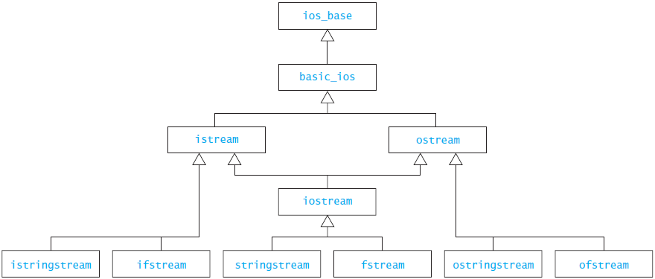
Introduction to Inheritance and Class Hierarchies (cont.)

Slide 8
Is-a Versus Has-a Relationships
The is-a relationship between classes means that every instance of one class is also an instance of the other class (but not the other way around)
  A jet airplane is an airplane, but not all airplanes are jet airplanes
The is-a relationship is represented in object oriented programming by extending a class
To say that a jet plane is an airplane means that the jet plane class is a derived class of the airplane class

Slide 9
Is-a Versus Has-a Relationships (cont.)
The has-a relationship between classes means that every instance of one class is or may be associated with one or more instances of the other class (but not necessarily the other way around)
  For example, a jet plane has a jet engine
The has-a relationship is represented by declaring in one class a data field whose type is another class

Slide 10
Is-a Versus Has-a Relationships (cont.)
We can combine is-a and has-a relationships
  A jet plane is an airplane, and it has a jet engine
  An airplane has a tail, so a jet plane does too because it is an airplane
C++ allows you to capture both the inheritance (is-a) relationship and the has-a relationship:
class Jet_Plane : public Airplane {
private:
int num_engines;
Jet_Engine jets[4]; // Jet planes have up to 4 engines.
// ...
};

Slide 11
Is-a Versus Has-a Relationships (cont.)
We can combine is-a and has-a relationships
  A jet plane is an airplane, and it has a jet engine
  An airplane has a tail, so a jet plane does too because it is an airplane
C++ allows you to capture both the inheritance (is-a) relationship and the has-a relationship:
class Jet_Plane : public Airplane {
private:
int num_engines;
Jet_Engine jets[4]; // Jet planes have up to 4 engines.
// ...
};
The part of the class heading following the colon specifies that Jet_Plane is a derived class of Airplane

Slide 12
Is-a Versus Has-a Relationships (cont.)
We can combine is-a and has-a relationships
  A jet plane is an airplane, and it has a jet engine
  An airplane has a tail, so a jet plane does too because it is an airplane
C++ allows you to capture both the inheritance (is-a) relationship and the has-a relationship:
class Jet_Plane : public Airplane {
private:
int num_engines;
Jet_Engine jets[4]; // Jet planes have up to 4 engines.
// ...
};
The data field jets (type Jet_Engine[4]) stores information for up to 4 jet engines for a Jet_Plane object.

Slide 13

A Base Class and a Derived Class
A computer has a:
  manufacturer
  processor
  RAM
  disk

Slide 14

A Base Class and a Derived Class (cont.)
A laptop computer is a kind of computer, so it has all the properties of a computer plus some additional features:
  screen size
  weight
We can define class Lap_Top as a derived class of class Computer

Slide 15
A Base Class and a Derived Class (cont.)

Slide 16
Class Computer
Computer.h
Computer.cpp
#ifndef COMPUTER_H_
#define COMPUTER_H_
#include <string>
class Computer {
private:
std::string manufacturer;
std::string processor;
int ram_size;
int disk_size;
public:
Computer(const std::string& man,
const std::string proc,
int ram, int disk) :
manufacturer(man), processor(proc),
ram_size(ram), disk_size(disk) {}
int get_ram_size() const { return ram_size; }
int get_disk_size() const { return disk_size; }
// ...
std::string to_string() const;
};
#endif
#include "Computer.h"
#include <sstream>
using std::ostringstream;
using std::string;
string Computer::to_string() const {
ostringstream sb;
sb << "Manufacturer: " << manufacturer
<< "\nCPU: " << processor
<< "\nRAM: " << ram_size << " megabytes"
<< "\nDisk: " << disk_size << " gigabytes";
return sb.str();
}

Slide 17
Class Computer
Computer.h
Computer.cpp
#ifndef COMPUTER_H_
#define COMPUTER_H_
#include <string>
class Computer {
private:
std::string manufacturer;
std::string processor;
int ram_size;
int disk_size;
public:
Computer(const std::string& man,
const std::string proc,
int ram, int disk) :
manufacturer(man), processor(proc),
ram_size(ram), disk_size(disk) {}
int get_ram_size() const { return ram_size; }
int get_disk_size() const { return disk_size; }
// ...
std::string to_string() const;
};
#endif
#include "Computer.h"
#include <sstream>
using std::ostringstream;
using std::string;
string Computer::to_string() const {
ostringstream sb;
sb << "Manufacturer: " << manufacturer
<< "\nCPU: " << processor
<< "\nRAM: " << ram_size << " megabytes"
<< "\nDisk: " << disk_size << " gigabytes";
return sb.str();
}
We refer to the standard string class using the fully qualified name
std::string in file Computer.h

Slide 18
Class Computer
Computer.h
Computer.cpp
#ifndef COMPUTER_H_
#define COMPUTER_H_
#include <string>
class Computer {
private:
std::string manufacturer;
std::string processor;
int ram_size;
int disk_size;
public:
Computer(const std::string& man,
const std::string proc,
int ram, int disk) :
manufacturer(man), processor(proc),
ram_size(ram), disk_size(disk) {}
int get_ram_size() const { return ram_size; }
int get_disk_size() const { return disk_size; }
// ...
std::string to_string() const;
};
#endif
#include "Computer.h"
#include <sstream>
using std::ostringstream;
using std::string;
string Computer::to_string() const {
ostringstream sb;
sb << "Manufacturer: " << manufacturer
<< "\nCPU: " << processor
<< "\nRAM: " << ram_size << " megabytes"
<< "\nDisk: " << disk_size << " gigabytes";
return sb.str();
}
But we use the abbreviated name string in file
Computer.cpp

Slide 19
Class Computer
Computer.h
Computer.cpp
#ifndef COMPUTER_H_
#define COMPUTER_H_
#include <string>
class Computer {
private:
std::string manufacturer;
std::string processor;
int ram_size;
int disk_size;
public:
Computer(const std::string& man,
const std::string proc,
int ram, int disk) :
manufacturer(man), processor(proc),
ram_size(ram), disk_size(disk) {}
int get_ram_size() const { return ram_size; }
int get_disk_size() const { return disk_size; }
// ...
std::string to_string() const;
};
#endif
#include "Computer.h"
#include <sstream>
using std::ostringstream;
using std::string;
string Computer::to_string() const {
ostringstream sb;
sb << "Manufacturer: " << manufacturer
<< "\nCPU: " << processor
<< "\nRAM: " << ram_size << " megabytes"
<< "\nDisk: " << disk_size << " gigabytes";
return sb.str();
}
We can do this in file Computer.cpp because it contains the statement
using string::std;
The reason we did not put the using statement in file
Computer.h is discussed in Section 3.5.

Slide 20
Class Lap_Top
Lap_Top.h
#ifndef LAP_TOP_H_
#define LAP_TOP_H_
#include "Computer.h"
class Lap_Top : public Computer {
private:
double screen_size;
double weight;
public:
Lap_Top(const std::string& man, const std::string& proc,
int ram, int disk, double screen, double wei) :
Computer(man, proc, ram, disk), screen_size(screen), weight(wei) {}
};
#endif

Slide 21
Class Lap_Top
Lap_Top.h
#ifndef LAP_TOP_H_
#define LAP_TOP_H_
#include "Computer.h"
class Lap_Top : public Computer {
private:
double screen_size;
double weight;
public:
Lap_Top(const std::string& man, const std::string& proc,
int ram, int disk, double screen, double wei) :
Computer(man, proc, ram, disk), screen_size(screen), weight(wei) {}
};
#endif
This line indicates that class Lap_Top is derived from class Computer and inherits its member data and
member functions

Slide 22
Class Lap_Top
Lap_Top.h
#ifndef LAP_TOP_H_
#define LAP_TOP_H_
#include "Computer.h"
class Lap_Top : public Computer {
private:
double screen_size;
double weight;
public:
Lap_Top(const std::string& man, const std::string& proc,
int ram, int disk, double screen, double wei) :
Computer(man, proc, ram, disk), screen_size(screen), weight(wei) {}
};
#endif
If we omit the keyword public when we declare a derived class, we will declare a derived class with private inheritance. This means that the derived class will inherit the data fields and functions of the base class, but they will not be visible to client classes.

Slide 23
Initializing Data Fields in a Derived Class
Lap_Top.h
#ifndef LAP_TOP_H_
#define LAP_TOP_H_
#include "Computer.h"
class Lap_Top : public Computer {
private:
double screen_size;
double weight;
public:
Lap_Top(const std::string& man, const std::string& proc,
int ram, int disk, double screen, double wei) :
Computer(man, proc, ram, disk), screen_size(screen), weight(wei) {}
};
#endif
The constructor for class Lap_Top must begin by initializing the four data fields inherited from class Computer. Because those data fields are private to the base class, C++ requires that they be initialized by a base class constructor

Slide 24
Initializing Data Fields in a Derived Class (cont.)
Lap_Top.h
#ifndef LAP_TOP_H_
#define LAP_TOP_H_
#include "Computer.h"
class Lap_Top : public Computer {
private:
double screen_size;
double weight;
public:
Lap_Top(const std::string& man, const std::string& proc,
int ram, int disk, double screen, double wei) :
Computer(man, proc, ram, disk), screen_size(screen), weight(wei) {}
};
#endif
We indicate this by inserting a call to the Computer constructor as the first initialization expression (following the “:”)

Slide 25
Initializing Data Fields in a Derived Class (cont.)
Lap_Top.h
#ifndef LAP_TOP_H_
#define LAP_TOP_H_
#include "Computer.h"
class Lap_Top : public Computer {
private:
double screen_size;
double weight;
public:
Lap_Top(const std::string& man, const std::string& proc,
int ram, int disk, double screen, double wei) :
Computer(man, proc, ram, disk), screen_size(screen), weight(wei) {}
};
#endif
The Computer constructor (indicated here by its signature) is run before the Lap_Top constructor

Slide 26
The No-Parameter Constructor
If the execution of any constructor in a derived class does not invoke a base class constructor, C++ automatically invokes the no-parameter constructor for the base class
C++ does this to initialize the part of the object inherited from the base class before the derived class starts to initialize its part of the object

Slide 27
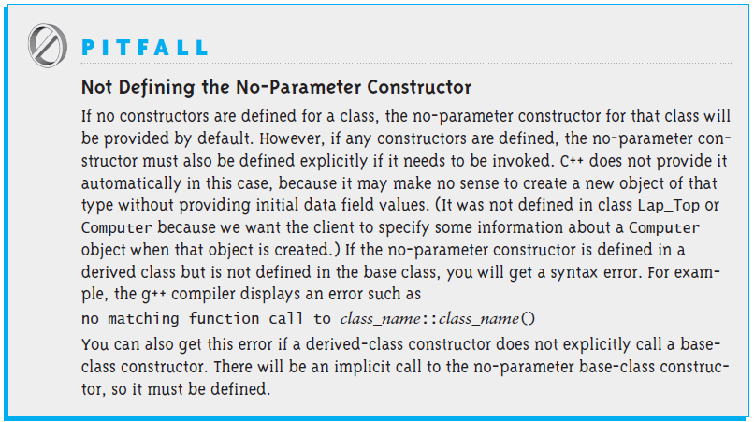
The No-Parameter Constructor (cont.)

Slide 28
Protected Visibility for Base-Class Data Fields
The data fields inherited from class Computer have private visibility—they can be accessed only within class Computer
The following assignment statement would not be valid in class Lap_Top:
manufacturer = man;
C++ provides a less restrictive form of visibility called protected visibility to allow a derived class to directly access data fields declared in its base class
A data field (or member function) with protected visibility can be accessed in the class defining it and in any class derived class from that class
If class Computer had the declaration
protected:
string manufacturer;
the assignment statement above would be valid in class Lap_Top
In general, it is better to use private visibility in classes because derived classes may be written by different programmers and it is always good practice to restrict and control access to base-class data fields

Slide 29
Member Function Overriding, Member Function Overloading, and Polymorphism
Section 3.2

Slide 30
Member Function Overriding
int main() {
Computer my_computer("Acme", "Intel P4 2.4", 512, 60);
Lap_Top your_computer("DellGate", "AMD Athlon 2000", 256, 40, 15.0, 7.5);
cout << "My computer is :\n" << my_computer.to_string() << endl;
cout << "\nYour computer is :\n" << your_computer.to_string() << endl;
}

Slide 31
Member Function Overriding (cont.)
int main() {
Computer my_computer("Acme", "Intel P4 2.4", 512, 60);
Lap_Top your_computer("DellGate", "AMD Athlon 2000", 256, 40, 15.0, 7.5);
cout << "My computer is :\n" << my_computer.to_string() << endl;
cout << "\nYour computer is :\n" << your_computer.to_string() << endl;
}
My computer is:
Manufacturer: Acme
CPU: Intel P4 2.4
RAM: 512 megabytes
Disk: 60 gigabytes
Your computer is:
Manufacturer: DellGate
CPU: AMD Athlon 2000
RAM: 256 megabytes
Disk: 40 gigabytes
Executing the code above produces the output displayed on the left

Slide 32
Member Function Overriding (cont.)
int main() {
Computer my_computer("Acme", "Intel P4 2.4", 512, 60);
Lap_Top your_computer("DellGate", "AMD Athlon 2000", 256, 40, 15.0, 7.5);
cout << "My computer is :\n" << my_computer.to_string() << endl;
cout << "\nYour computer is :\n" << your_computer.to_string() << endl;
}
My computer is:
Manufacturer: Acme
CPU: Intel P4 2.4
RAM: 512 megabytes
Disk: 60 gigabytes
Your computer is:
Manufacturer: DellGate
CPU: AMD Athlon 2000
RAM: 256 megabytes
Disk: 40 gigabytes
Even though your_computer is of type Lap_Top, the Lap_Top fields are not displayed; the call to to_string() calls the to_string() method inherited from Computer

Slide 33
Member Function Overriding (cont.)
To show the state of a laptop computer, complete with screen size and weight, we need to define a to_string member function for class Lap_Top
If class Lap_Top has its own to_string member function, it will override the inherited member function and will be invoked by the member function call your_computer.to_string()

Slide 34
Member Function Overriding (cont.)
string Lap_Top::to_string() const {
ostringstream sb;
sb << Computer::to_string()
<< "\nScreen Size: " << screen_size
<< "\nWeight: " << weight;
return sb.str();
}

Slide 35
Member Function Overriding (cont.)
string Lap_Top::to_string() const {
ostringstream sb;
sb << Computer::to_string()
<< "\nScreen Size: " << screen_size
<< "\nWeight: " << weight;
return sb.str();
}
Lap_Top cannot access the private data fields of Computer. To display them, we call Computer's to_string function

Slide 36
Member Function Overriding (cont.)
string Lap_Top::to_string() const {
ostringstream sb;
sb << Computer::to_string()
<< "\nScreen Size: " << screen_size
<< "\nWeight: " << weight;
return sb.str();
}
and then append Lap_Top's data fields

Slide 37
Member Function Overloading
If we decide to standardize and purchase our laptop computers from only one manufacturer we could introduce a new constructor with one less parameter:
Lap_Top(const std::string& proc, int ram, int disk,
double screen, double wei) :
Computer(DEFAULT_LT_MAN, proc, ram, disk),
screen_size(screen), weight(wei) {}
Having multiple member functions with the same name but different signatures in a class is called member function overloading

Slide 38
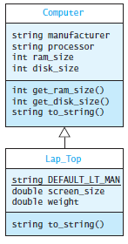
Member Function Overloading (cont.)
Both of the following statements are now valid:
Lap_Top ltp1("Intel P4 2.8", 256,
40, 14, 6.5);
Lap_Top ltp2("MicroSys",
"AMD Athlon 2000",
256, 40, 15, 7.5);
Since it is not specified, the manufacturer string for ltp1 will be assigned as DEFAULT_LT_MAN

Slide 39
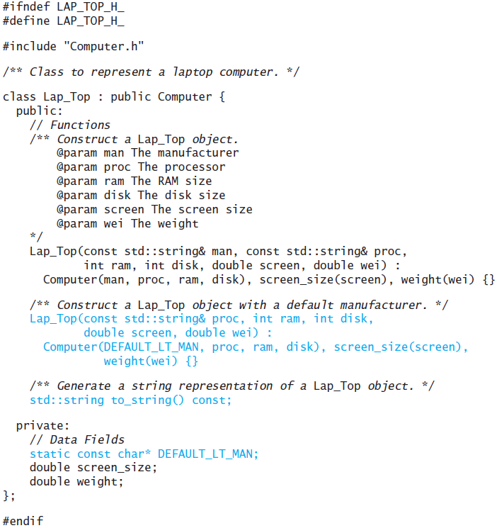
Member Function Overloading (cont.)

Slide 40
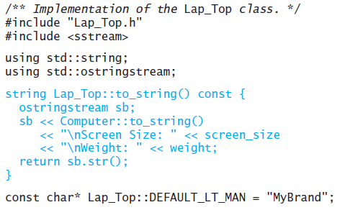
Member Function Overloading (cont.)

Slide 41
Virtual Functions and Polymorphism
The pointer variable
Computer* the_computer;
can be used to reference an object of either type Computer or type Lap_Top
In C++, a pointer variable of a baseclass type (general) can point to an object of a derived-class type (specific)
  Lap_Top objects are Computer objects with more features
Suppose you have purchased a laptop computer. What happens when the following
statements are executed?
the_computer = new Lap_Top("Bravo", "Intel P4 2.4", 256, 40, 15.0,
7.5);
cout << the_computer->to_string() << endl;
What will this function call return:
the_computer->to_string()
a string with all six data fields for a Lap_Top object (using Lap_Top::to_string) or just the four data fields defined for a Computer object (using Computer::to_string)?

Slide 42
Virtual Functions and Polymorphism (cont.)
The answer is: a string with just the four data fields because the_computer is type pointer-to-Computer
Manufacturer: Bravo
CPU: Intel P4 2.4
RAM: 256 megabytes
Disk: 40 gigabytes
In C++ it is possible for the type of the object receiving the to_string message to determine which to_string member function is called
We can do so by changing the declaration of the function to_string in the class Computer (in Computer.h) to a virtual function:
virtual std::string to_string() const;
If a member function is declared virtual when it is called through a pointer (or reference) variable the actual member function will be determined at run time and based on the type of the object pointed to (or referenced)

Slide 43
Virtual Functions and Polymorphism (cont.)
If the variable the_computer points to a Lap_Top object and the to_string function is declared as virtual, then the expression
the_computer->to_string()
will call the member function to_string defined by the Lap_Top class

Slide 44
Virtual Functions and Polymorphism (cont.)
The feature we just illustrated is an important concept in OOP called polymorphism
Polymorphism is the quality of having many forms or many shapes
Polymorphism enables the program to determine which member function to invoke at run time
In our example, at compile time, the C++ compiler cannot determine what type of object the_computer will point to (type Computer or its derived type Lap_Top)
At run time the program knows the type of the object that receives the to_string message and calls the appropriate to_string function

Slide 45
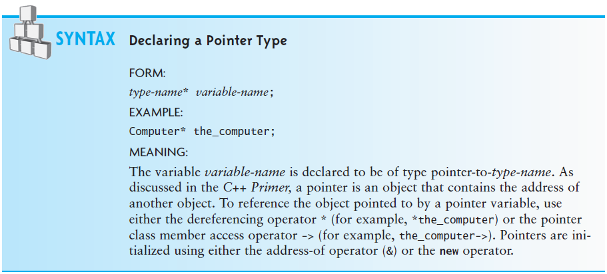
Virtual Functions and Polymorphism (cont.)

Slide 46
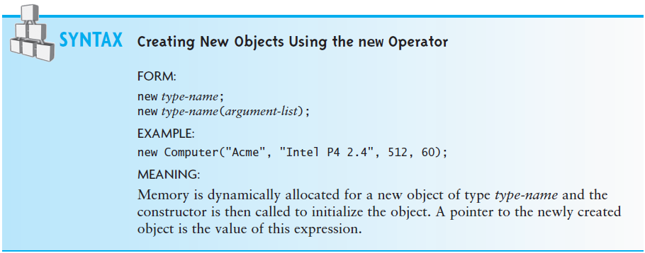
Virtual Functions and Polymorphism (cont.)

Slide 47
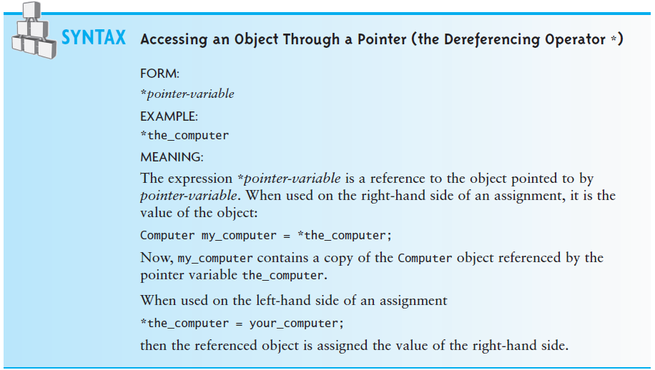
Virtual Functions and Polymorphism (cont.)

Slide 48
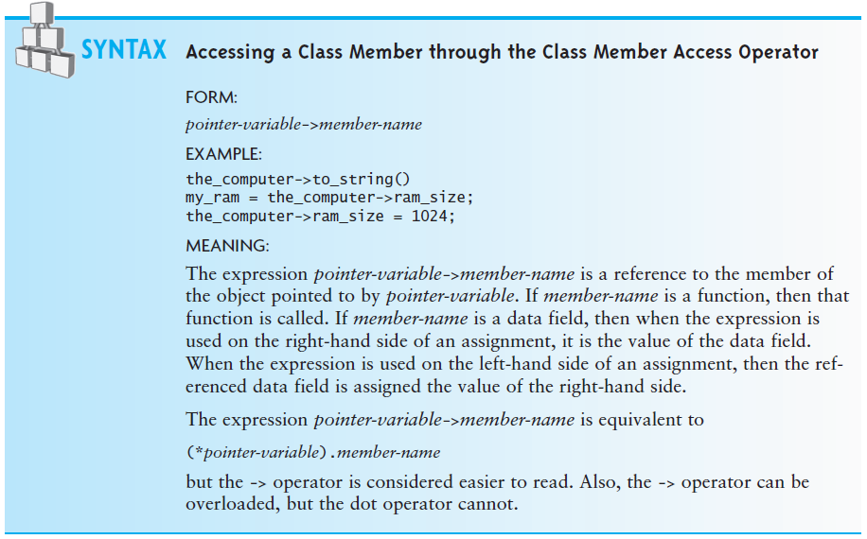
Virtual Functions and Polymorphism (cont.)

Slide 49
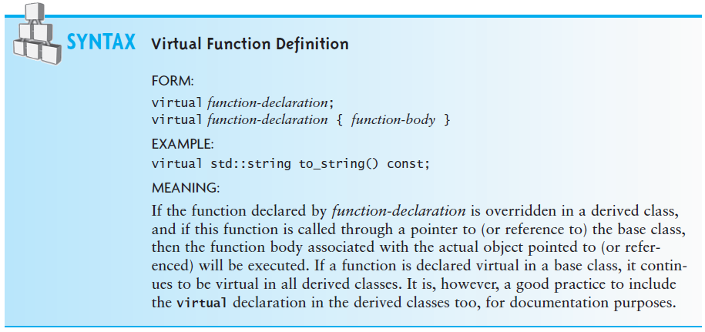
Virtual Functions and Polymorphism (cont.)

Slide 50
Virtual Functions and Polymorphism (cont.)
If we declare the array lab_computers as follows:
Computer* lab_computers[10];
we can store pointers to 10 Computer or Lap_Top objects in array lab_computers
We can use the following loop to display the information about each object in the array:
for (int i = 0; i < 10; i++)
cout << lab_computers[i]->to_string() << endl;
Because of polymorphism, the actual type of the object pointed to by lab_computers[i] determines which to_string member function will execute (Computer::to_string or Lap_Top::to_string) for each value of subscript i

Slide 51
Virtual Functions and Polymorphism (cont.)
We can define the ostream extraction operator for the Computer class as follows:
ostream& operator<<(ostream& os, const Computer& comp) {
return os << comp.to_string;
}
Because comp is a reference to Computer, when this function is called with a Lap_Top object, the Lap_Top::to_string member function will be called
When it is called with a Computer object, the Computer::to_string member function will be called

Slide 52
Abstract Classes, Assignment, and Casting in a Hierarchy
Section 3.3

Slide 53
Abstract Classes, Assignment, and Casting in a Hierarchy
An abstract class differs from an actual class (sometimes called a concrete class) in two respects:
  An abstract class cannot be instantiated
  An abstract class declares at least one abstract member function, which must be defined in its derived classes
An abstract function is a virtual function that is declared but for which no body (definition) is provided

Slide 54
Abstract Classes, Assignment, and Casting in a Hierarchy (cont.)
We use an abstract class in a class hierarchy when we need a base class for two or more actual classes that share some attributes
We may want to declare some of the attributes and define some of the functions that are common to these base classes
We may also want to require that the actual derived classes implement certain functions
We can accomplish this by declaring these functions abstract, which makes the base class abstract as well

Slide 55
Abstract Classes, Assignment, and Casting in a Hierarchy (cont.)
As an example, the Food Guide Pyramid provides a recommendation of what to eat each day based on established dietary guidelines
There are six categories of foods in the pyramid:
  fats, oils, and sweets
  meats, poultry, fish, and nuts
  milk, yogurt, and cheese
  vegetables
  fruits
  bread, cereal, and pasta
If we want to model the Food Guide Pyramid, we might make each of these an actual derived classes of an abstract class called Food as shown in the following listing:

Slide 56
Abstract Classes, Assignment, and Casting in a Hierarchy (cont.)
Food.h
#ifndef FOOD_H_
#define FOOD_H_
class Food {
private:
double calories;
public:
virtual double percent_protein() const = 0;
virtual double percent_fat() const = 0;
virtual double percent_carbohydrates() const = 0;
double get_calories() const { return calories; }
void set_calories(double cal) {
calories = cal;
}
};
#endif

Slide 57
Abstract Classes, Assignment, and Casting in a Hierarchy (cont.)
Food.h
#ifndef FOOD_H_
#define FOOD_H_
class Food {
private:
double calories;
public:
virtual double percent_protein() const = 0;
virtual double percent_fat() const = 0;
virtual double percent_carbohydrates() const = 0;
double get_calories() const { return calories; }
void set_calories(double cal) {
calories = cal;
}
};
#endif
These three virtual functions impose the requirement that all derived classes implement these three functions. We would expect a different function definition for each kind of food.

Slide 58
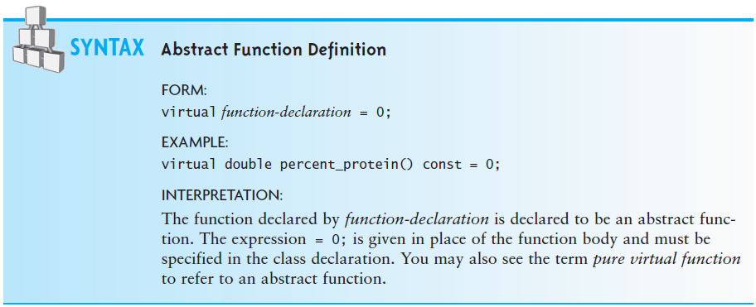
Abstract Classes, Assignment, and Casting in a Hierarchy (cont.)

Slide 59
Referencing Actual Objects
Because class Food is abstract, we can’t create type Food objects
The statement
Food my_snack();
is not valid
We can use a type Food pointer variable to point to an actual object that belongs to a class derived from Food
The following statement creates a Vegetable object (derived from Food) that is referenced by variable my_snack (type pointer-to-Food):
Food* my_snack = new Vegetable("carrot sticks");

Slide 60
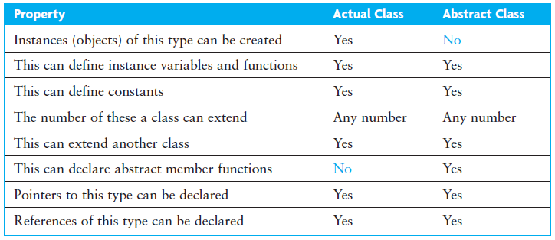
Summary of Features of Actual Classes and Abstract Classes

Slide 61
Assignments in a Class Hierarchy
C++ is what is known as a strongly typed language
Each operand has a type and operations can be performed only on operands of the same or compatible types
This includes the assignment operation:
l-value = r-value
For the built-in types the r-value (right value) must be of the same type as the l-value (left value) or there must be a conversion defined to convert the r-value into a value that is the same type as the l-value

Slide 62
Assignments in a Class Hierarchy (cont.)
For class types, the assignment operator may be overridden and overloaded (this is discussed in the following section)
There is an exception to this rule for pointer types:
  A pointer variable (l-value) that is of type pointer-to-base class may point to a derived object (r-value)
However, the opposite is not legal
Computer* a_computer = new Lap_Top( ... ); // Legal
Lap_Top* a_laptop = new Computer( ... ); // Incompatible types

Slide 63
Casting in a Class Hierarchy
C++ provides a mechanism, dynamic casting, that enables us to process the object referenced by a_computer through a pointer variable of its actual type, instead of through a type pointer-to-Computer
The expression
dynamic_cast<Lap_Top*>(a_computer)
casts the type of the object pointed to by a_computer
(type Computer) to type Lap_Top
The casting operation succeeds only if the object referenced by a_computer is, in fact, type Lap_Top; if not, the result is the null pointer

Slide 64
Casting in a Class Hierarchy (cont.)
Casting gives us a type Lap_Top pointer to the object that can be processed just like any other type Lap_Top pointer
The expression
dynamic_cast<Lap_Top*>(a_computer)->get_weight()
will compile because now get_weight is applied to a type Lap_Top
reference
Similarly, the assignment statement
Lap_Top* a_laptop = dynamic_cast<Lap_Top*>(a_computer);
is valid because a type Lap_Top pointer is being assigned to a_laptop (type Lap_Top*)
Keep in mind that the casting operation does not change the object pointed to by a_computer; instead, it creates a type Lap_Top pointer to it (This is called an anonymous or unnamed pointer)

Slide 65
Casting in a Class Hierarchy (cont.)
Using the type Lap_Top pointer, we can invoke any member function of class Lap_Top and process the object just like any other type Lap_Top object
The cast
dynamic_cast<Lap_Top*>(a_computer)
is called a downcast because we are casting from a higher type in the inheritance hierarchy (Computer) to a lower type (Lap_Top)
Microsoft compilers require you to set a compiler switch to use dynamic_cast

Slide 66
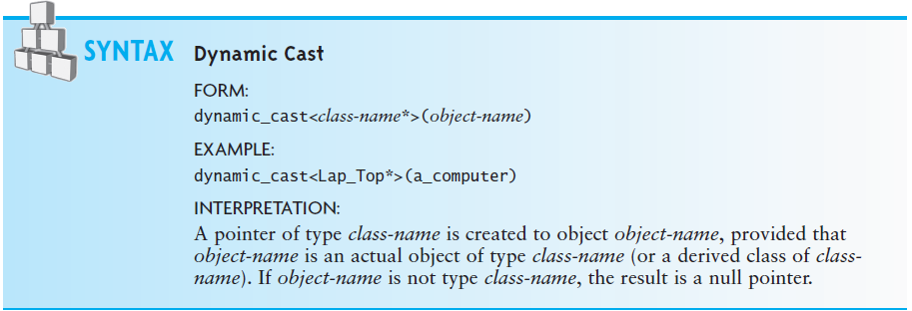
Casting in a Class Hierarchy (cont.)

Slide 67
CASE STUDY: Displaying Addresses for Different Countries
PROBLEM:
  Different countries use different conventions when addressing mail
  We want to write a program that will display the address in the correct format depending on the destination
  Specifically, we want to distinguish between addresses in Germany and in the United States and Canada
  In Germany the building number follows the street name (line 1 below), and the postal code (equivalent to the U.S. ZIP code) is placed before the municipality name (line 2 below)
    This is the opposite of the convention used in the United States and Canada. For example, a typical German address would read
    Bahnhofstr 345
    D-99999 Jedenstadt
  while a typical U.S. and Canadian address would read
    123 Main St
    Somecity ZZ 99999-9999
  However, the Canadian postal code is in a different format

Slide 68
CASE STUDY: Displaying Addresses for Different Countries (cont.)
ANALYSIS:
  Several components make up an address, and there are numerous variations between countries as to how to arrange them
  One simple approach would be to ignore these variations and merely record complete address lines as strings
  However, this approach does not allow us to analyze or validate addresses easily
  By parsing the addresses into their components, we can validate addresses against databases provided by the national postal authorities and generate address labels that conform to national postal authority standards
  There are several commercial software packages and databases that do this

Slide 69
CASE STUDY: Displaying Addresses for Different Countries (cont.)
ANALYSIS (cont.):
  The number of components in an address and their names vary among countries
  We simplify this situation for the purposes of this case study
  An address will consist of the following data elements:
    the house number
    the street name
    the municipality
    the state or province
    the postal code

Slide 70
CASE STUDY: Displaying Addresses for Different Countries (cont.)
ANALYSIS (cont.):
A German address is organized as follows:
<street name><house number>
<postal code><municipality>
A U.S./Canadian address, on the other hand, is organized this way:
<house number><street name>
<municipality><state or province><postal code>
Because we are originating the mail from the United States, the German address will have the additional requirement that the name of the destination country (Germany) be placed on a third line below the line containing the postal code and municipality

Slide 71
CASE STUDY: Displaying Addresses for Different Countries (cont.)
DESIGN:
We will create an abstract class, Address, that will contain the data elements
This class will also have the abstract function to_string, which will require the derived classes to organize the elements into a format required for the destination country
The derived classes German_Address and US_Address will then implement the to_string function; the next slide shows the UML diagram
  The # next to an attribute indicates that it has protected visibility

Slide 72
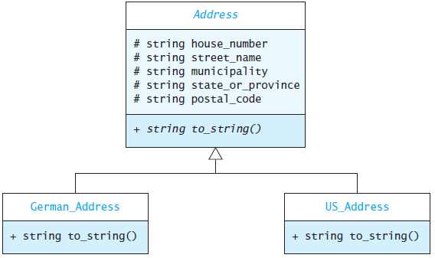
CASE STUDY: Displaying Addresses for Different Countries (cont.)
DESIGN (cont.):

Slide 73
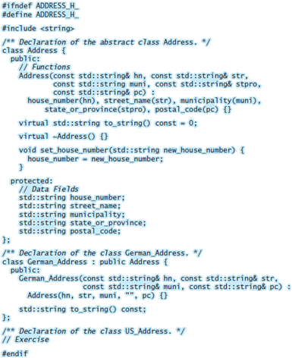
CASE STUDY: Displaying Addresses for Different Countries (cont.)
IMPLEMENTATION:

Slide 74
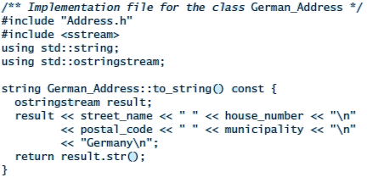
CASE STUDY: Displaying Addresses for Different Countries (cont.)
IMPLEMENTATION:

Slide 75
Multiple Inheritance
Section 3.4

Slide 76
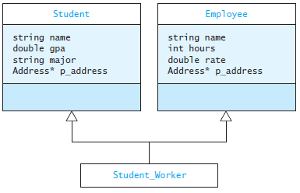
Multiple Inheritance
Multiple inheritance refers the ability of a class to extend more than one class
For example, a university has many students who are full-time students and many employees who are full-time employees, but also some student employees (who are both students and employees)

Slide 77
Multiple Inheritance (cont.)
In multiple inheritance, all the data fields for the derived class are inherited from its base classes
Multiple inheritance is a language feature that can lead to ambiguity; if a class extends two classes, and each declares the same data field (for example, name in Student and Employee), which one does the derived class inherit?
In C++, the answer is both
We will show how C++ handles this
(Because of the ambiguity problem, the Java programming language does not support multiple inheritance)

Slide 78
Definition of Student_Worker
Student_Worker.h
#ifndef STUDENT_WORKER_H_
#define STUDENT_WORKER_H_
#include "Employee.h"
#include "Student.h"
class Student_Worker : public Employee, public Student {
public:
Student_Worker(const std::string& the_name,
Address* the_address,
double the_rate,
const std::string& the_major) :
Employee(the_name, the_address, the_rate),
Student(the_name, the_address, the_major) {}
std::string to_string() const;
};
#endif

Slide 79
Definition of Student_Worker (cont.)
Student_Worker.h
#ifndef STUDENT_WORKER_H_
#define STUDENT_WORKER_H_
#include "Employee.h"
#include "Student.h"
class Student_Worker : public Employee, public Student {
public:
Student_Worker(const std::string& the_name,
Address* the_address,
double the_rate,
const std::string& the_major) :
Employee(the_name, the_address, the_rate),
Student(the_name, the_address, the_major) {}
std::string to_string() const;
};
#endif
The heading shows that class Student_Worker extends class Employee and class Student

Slide 80
Definition of Student_Worker (cont.)
Student_Worker.h
#ifndef STUDENT_WORKER_H_
#define STUDENT_WORKER_H_
#include "Employee.h"
#include "Student.h"
class Student_Worker : public Employee, public Student {
public:
Student_Worker(const std::string& the_name,
Address* the_address,
double the_rate,
const std::string& the_major) :
Employee(the_name, the_address, the_rate),
Student(the_name, the_address, the_major) {}
std::string to_string() const;
};
#endif
The constructor contains two initialization expressions separated by a comma

Slide 81
Definition of Student_Worker (cont.)
Student_Worker.h
#ifndef STUDENT_WORKER_H_
#define STUDENT_WORKER_H_
#include "Employee.h"
#include "Student.h"
class Student_Worker : public Employee, public Student {
public:
Student_Worker(const std::string& the_name,
Address* the_address,
double the_rate,
const std::string& the_major) :
Employee(the_name, the_address, the_rate),
Student(the_name, the_address, the_major) {}
std::string to_string() const;
};
#endif
The first initializes the Employee part

Slide 82
Definition of Student_Worker (cont.)
Student_Worker.h
#ifndef STUDENT_WORKER_H_
#define STUDENT_WORKER_H_
#include "Employee.h"
#include "Student.h"
class Student_Worker : public Employee, public Student {
public:
Student_Worker(const std::string& the_name,
Address* the_address,
double the_rate,
const std::string& the_major) :
Employee(the_name, the_address, the_rate),
Student(the_name, the_address, the_major) {}
std::string to_string() const;
};
#endif
The second initializes the Student part

Slide 83
Definition of Student_Worker (cont.)
Student_Worker.h
#ifndef STUDENT_WORKER_H_
#define STUDENT_WORKER_H_
#include "Employee.h"
#include "Student.h"
class Student_Worker : public Employee, public Student {
public:
Student_Worker(const std::string& the_name,
Address* the_address,
double the_rate,
const std::string& the_major) :
Employee(the_name, the_address, the_rate),
Student(the_name, the_address, the_major) {}
std::string to_string() const;
};
#endif
There is no argument given for data fields hours or gpa, so they are initialized to default values

Slide 84
Definition of Student_Worker (cont.)
Student_Worker.cpp
/** Return string representation of Student_Worker. */
std::string Student_Worker::to_string() const {
std::ostringstream result;
result << name << '\n'
<< p_address->to_string()
<< "\nMajor: " << major
<< " GPA: " << gpa
<< " rate: " << rate
<< " hours: " << hours;
return result.str();
}

Slide 85
Definition of Student_Worker (cont.)
Student_Worker.cpp
/** Return string representation of Student_Worker. */
std::string Student_Worker::to_string() const {
std::ostringstream result;
result << name << '\n'
<< p_address->to_string()
<< "\nMajor: " << major
<< " GPA: " << gpa
<< " rate: " << rate
<< " hours: " << hours;
return result.str();
}
When we attempt to compile Student_Worker.cpp, we receive an error message that says that the references to name and p_address are ambiguous

Slide 86
Definition of Student_Worker (cont.)
Student_Worker.cpp
/** Return string representation of Student_Worker. */
std::string Student_Worker::to_string() const {
std::ostringstream result;
result << Student::name << '\n'
<< Student::p_address->to_string()
<< "\nMajor: " << major
<< " GPA: " << gpa
<< " rate: " << rate
<< " hours: " << hours;
return result.str();
}
We can fix this by modifying the code as shown

Slide 87
Definition of Student_Worker (cont.)
Student_Worker.cpp
/** Return string representation of Student_Worker. */
std::string Student_Worker::to_string() const {
std::ostringstream result;
result << Student::name << '\n'
<< Student::p_address->to_string()
<< "\nMajor: " << major
<< " GPA: " << gpa
<< " rate: " << rate
<< " hours: " << hours;
return result.str();
}
While this resolved the error, it is not a very good solution. We still effectively have two name data fields and two p_address data fields, even though the constructor sets them both to the same value. Because the two p_address fields are the same, we may get a run-time error when the destructor for Student_Worker is called

Slide 88
Refactoring the Employee and Student Classes
A better solution is to recognize that both Employees and Students have common data fields
These common data fields and their associated member functions could be collected into a separate class, which would become a common base class Person
This process is known as refactoring and is often used in object-oriented design
However, it leads to similar problems, because there are two Person components in the Student_Worker class: one inherited from Employee and the other inherited from Student
A workable solution to this problem is beyond the scope of the chapter
  you can find this solution in Appendix A.4

Slide 89
Namespaces and Visibility
Section 3.5

Slide 90
Namespaces
The entire C++ standard library is contained in the namespace std
Namespaces are used to group collections of declarations into a functional unit
By using namespaces, clashes between duplicate names are avoided
  An adventure game program may define the class map to represent the area where the action takes place
  The standard library also defines a class called map, which associates values with keys (discussed in Chapter 9)
  To avoid clashes between the two map classes, we prefix the namespace name before the class name

Slide 91
Namespaces (cont.)
This declaration of a class map uses the standard map as a component:
#include <map> // Get defn of standard map
class map {
private:
std::map the_map; // Declare a component.
...
};

Slide 92
Declaring a Namespace
We could make the distinction even clearer by defining our own namespace game and placing all the definitions associated with this program into this namespace
namespace game {
class map { ... };
}
Then these declarations declare objects of different classes:
std::map a_std_map; // A standard map
game::map a_game_map;

Slide 93
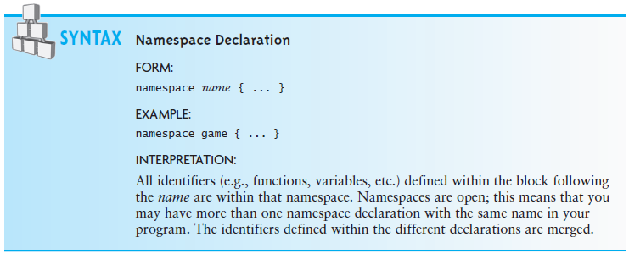
Declaring a Namespace (cont.)

Slide 94
The Global Namespace
Namespaces are nested:
  The global namespace is at the top level; its name is effectively the null string
  By default symbols exist in a global namespace unless they are defined inside a block that starts with keyword namespace or members of a class or local variables of a function
  In our map example, the distinction is between std::map and ::map
  Since the reference to ::map is made within the default namespace, the leading prefix :: (the scope resolution operator) is not required
If we defined the namespace game but did not define the map class inside of it, code within the scope of namespace game that referenced class map, defined in the global namespace, would still require the :: qualifier, e.g., ::map

Slide 95
The Global Namespace (cont.)
The fragment below declares a class map in the global namespace and one in the game namespace
class map { ... }; // Defined in the global namespace
namespace game {
class map { ... }; // Defined in the game namespace
}
The statement
map map1;
in the global namespace declares an object map1 of type ::map (that is, the map defined in the global namespace)
The statement
game::map map2
in the global namespace declares an object map2 of type game::map
(that is the map defined in namespace game)

Slide 96
The Global Namespace (cont.)
The statements
namespace game {
map map4; // map4 is the map defined in the game namespace.
::map map5; // map5 is the map defined in the global namespace.
}
are in the game namespace.
The object map4 is of the map class that is declared in the game namespace
The object map5 is of the type map defined in the global namespace

Slide 97
The using Declaration and using Directive
The using declaration takes a name from the namespace in which it was declared and places it into the namespace where the using declaration appears
  EXAMPLE:
  using std::cout;
  The qualified name (cout) is now a member of the namespace in which the using declaration appears

Slide 98
The using Declaration and using Directive (cont.)
The using directive takes all of the names from a given namespace and places them into the namespace where the using directive appears
  EXAMPLE:
  using namespace std;
  All of the names defines in std now are defined as such within the current namespace

Slide 99
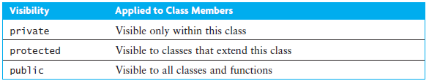
Using Visibility to Support Encapsulation

Slide 100
The friend Declaration
The friend declaration allows a function external to a class to access the private members of that class
The friend declaration gives the functions and classes it specifies access to the private and protected members of the class in which the friend declaration appears
This effectively makes the named function or class a member of the declaring class
The class itself must declare who its friends are
Also, friendship is not inherited and is not transitive
  This means that if a base class is a friend of a particular class, its derived classes are not automatically friends too
  They must be declared to be friends

Slide 101
The friend Declaration (cont.)
class A {
private:
int x;
friend foo;
}
class B {
void foo() {
A a;
// . . .
a.x = 10; // Valid, foo is a friend of A and a is an object of class A.
}
}
Class C {
void bar() {
A a;
// . . .
a.x = 10; // Not valid, x is not visible to bar.
}
}

Slide 102
The friend Declaration (cont.)
class A {
private:
int x;
friend class B;
};
class B {
private:
int y;
void foo() {
A a;
a.x = 10; // Legal, B is a friend of A.
}
friend class C;
};
class C {
void bar() {
A a;
B b;
b.y = 10; // Legal, C is a friend of B.
a.x = 10; // Not valid, C is not a friend of A.
}
};

Slide 103
A Shape Class Hierarchy
Section 3.6

Slide 104
Case Study: Processing Geometric Figures
  PROBLEM
    We want to process some standard geometric shapes. Each figure object will be one of three standard shapes (rectangle, circle, right triangle)
    We want to do standard computations, such as finding the area and perimeter, for any of these shapes
  ANALYSIS
    For each geometric shape, we need a class that represents the shape and knows how to perform the standard computations on it
    These classes will be Rectangle, Circle, and Rt_Triangle
    To ensure that these shape classes all define the required computational methods we will require them to implement an abstract class, Shape
    If a class does not have the required functions, we will get a syntax error when we attempt to use it

Slide 105
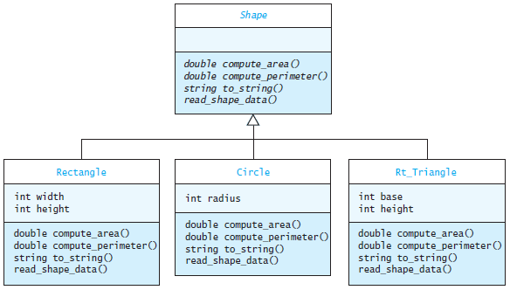
Shape Class Hierarchy

Slide 106
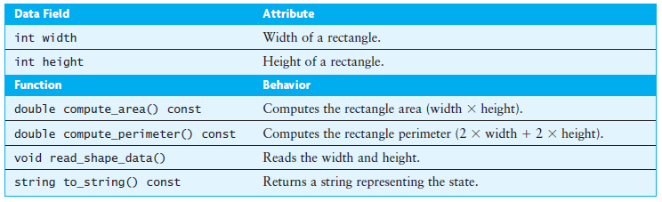
Class Rectangle

Slide 107
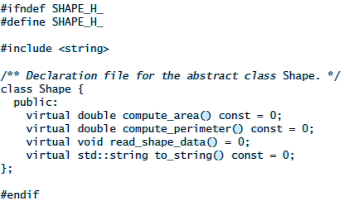
Implementation

Slide 108

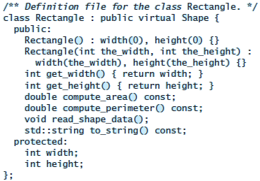
Implementation (cont.)

Slide 109
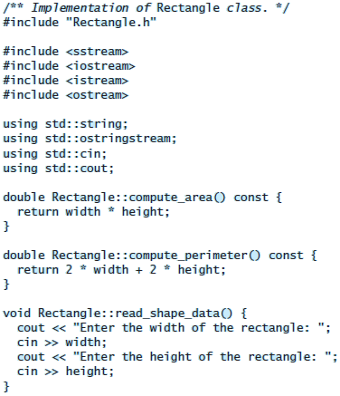
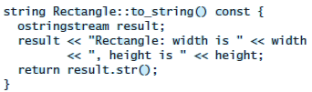
Implementation (cont.)

Slide 110
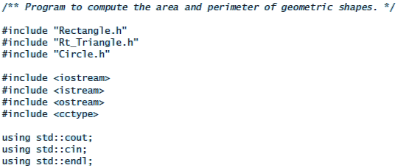
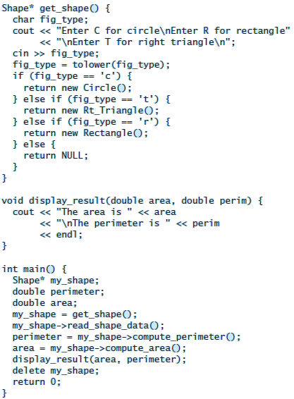
Testing

Slide 111
Testing (cont.)
The function get_shape is an example of a factory function
    it creates a new object and returns a pointer to it
  The author of the main function has no awareness of the individual kinds of shapes
  Knowledge of the available shapes is confined to the get_shape function; this function must
    present a list of available shapes to the user
    decode the user’s response
    return an instance of the desired shape

